Slide 1
Project Benson: Strategies for Optimizing Street Team Placements Dean / Dereck / Joe / Kendall 01/22/2018

Slide 2
The Gala
How to place street teams?
Leverage historical MTA data

Slide 3
Methodology
Assumptions
Data Cleaning / Aggregation
Recommendations

Slide 4
Data Cleaning & Aggregation

Slide 5
Data Issues
Reset Counts
Turnstile rolling back
Different time interval
How to standardize counts?

Slide 6
Data Cleaning
Two methods considered
Resampling & Interpolation
Weighted Average

Slide 7
Data Aggregation
Pivot table (groupby)
Total traffic by station and date

Slide 8
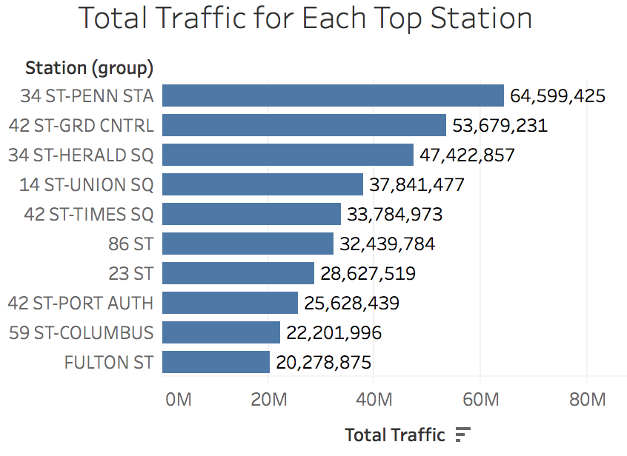
Top Stations with Most Traffic

Slide 9
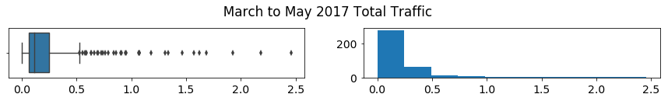

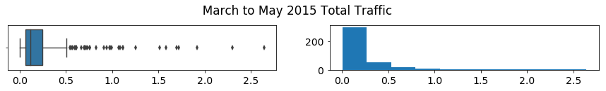
Top Stations with Most Traffic

Slide 10
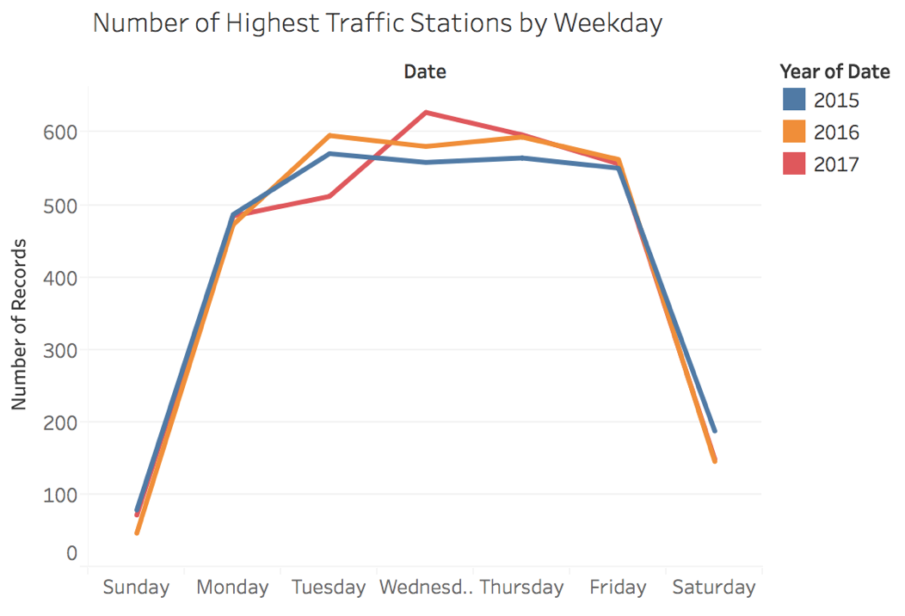
Observations #1: More high traffic stations on weekdays

Slide 11
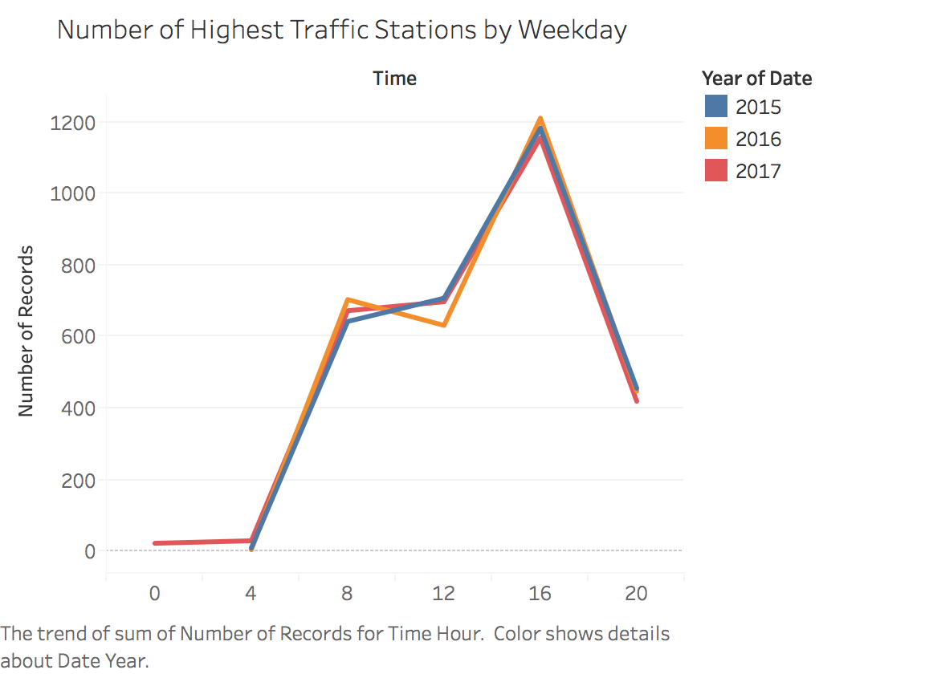
Observations #2: More high traffic stations from 4- 8 PM

Slide 12
Recommendations

Slide 13
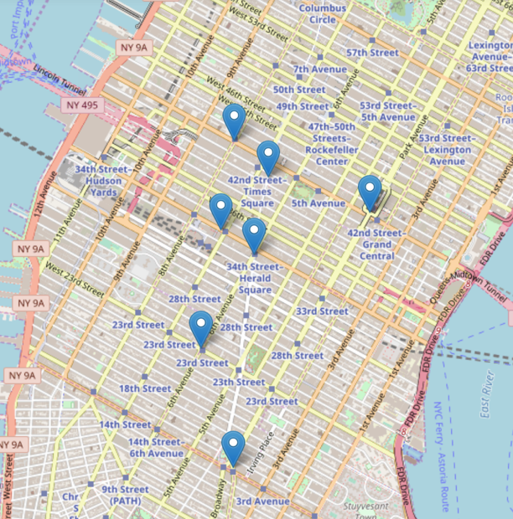
Recommendation #1: The Common Sense Approach
Spring – Weekdays – 4 ~ 8 PM
Penn Station
Grand Central
Time Square
…
Notes:
1) The common sense approach: Top Traffic stations 2) The Quality over Quantity Approach: Pick zip codes of colleges, universities, pro-women organizations and find max station 3) The Opportunistic Approach: Conferences, concerts, holidays and etc.

Slide 14
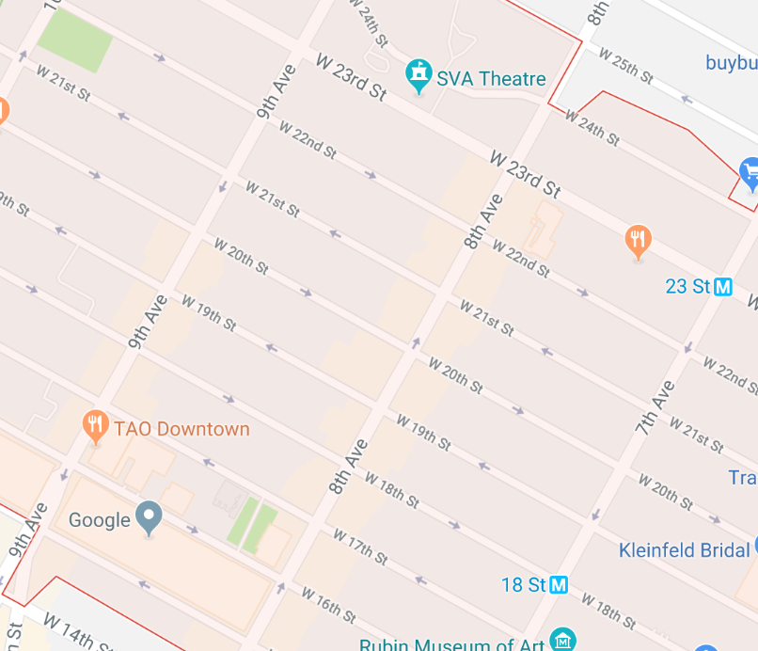
Recommendation #2: Next Step Quality over Quantity Approach
Location targeting (Tech companies, Universities, Pro-women Groups)
Find highest traffic stations in nearby zip codes
Notes:
1) The common sense approach: Top Traffic stations 2) The Quality over Quantity Approach: Pick zip codes of colleges, universities, pro-women organizations and find max station 3) The Opportunistic Approach: Conferences, concerts, holidays and etc.

Slide 15

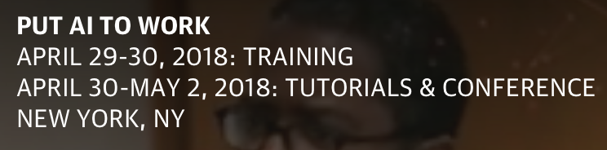
Recommendation #3: Next Step The Opportunistic Approach
Events targeting (Tech/Women’s Conferences, Concerts)
Identify events date/time/location and stations nearby
Notes:
1) The common sense approach: Top Traffic stations 2) The Quality over Quantity Approach: Pick zip codes of colleges, universities, pro-women organizations and find max station 3) The Opportunistic Approach: Conferences, concerts, holidays and etc.

Slide 16
Thank You!

